Slide 1



first informal consultation workshop on HELCOM and OSPAR underwater noise data upload 3-4 October 2023 ICES Secretariat, at H. C. Andersens Boulevard 44-46, 1553, Copenhagen
Fritjof Basan– M23 – Federal Maritime and Hydrographic Agency of Germany

Slide 2
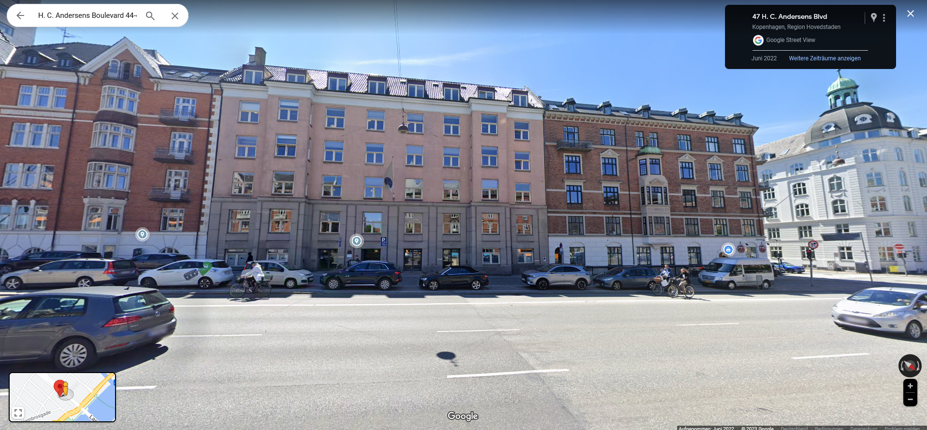
Welcome to/from Copenhagen
Aim or Workshop:
Enable all participants to convert their continuous data to ICES hdf5 format and upload their data to ICES database.
Enable and enhance harmonized approach of sharing of impulsive noise events
Identify problems and discuss how to move forward.

Slide 3
Structure of the Week
TUESDAY | WEDNESDAY | THURSDAY | FRIDAY
Data Conversion and Upload Workshop 13:00 – 17:30 | Data Conversion and Upload Workshop 09:00 – 13:00 Joint ICG/EG-Noise meeting afternoon | Joint ICG/EG-Noise meeting Whole day | Meeting of ICG subgroup on continuous noise morning

Slide 4
Agenda of the Workshop
3 October 2023
4 October 2023
CEST time
13:00 | Get together
13:30 | Welcome and structure of the workshop
13:40 | Introduction round
14:00 | Impulsive Noise Session
16:00 | Coffee Break
16:15 | Presentation of database and hdf5 format (ICES)
17:00 | Overview on methods to calculate TOLs
17:30 | Wrap up of day 1
CEST time
09:00 | Methods of data conversion and upload
10:30 | Practical session
12:00 | Discussion on identified problems
13:00 | Closing of the workshop
Aim of workshop:
Enable everyone to convert data and upload it to ICES (for both continuous and impulsive noise)
Improve workflow and share experiences and scripts
Suggest Improvements of ICES User Interface
Identify Knowledge/Technology Gaps

Slide 5
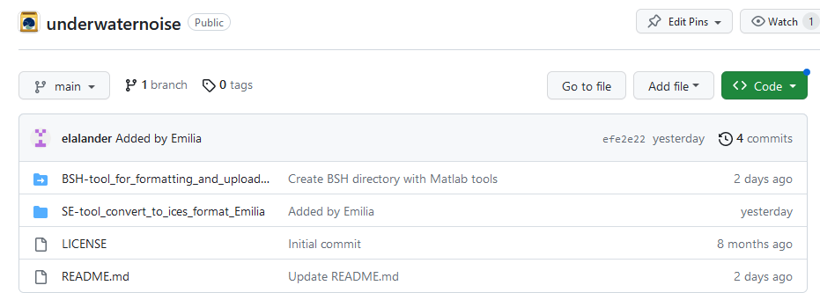
Scripts, Tools and Data
Should have been made available prior to workshop on ICES github page https://github.com/ices-tools-prod/underwaternoise :
Data will be made available there as soon as possible and should also be kept up to date
Data now available either on USB-stick or via wetransfer link in Chat!

Slide 6
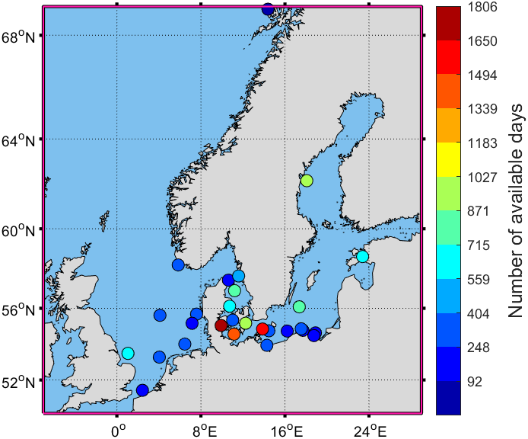
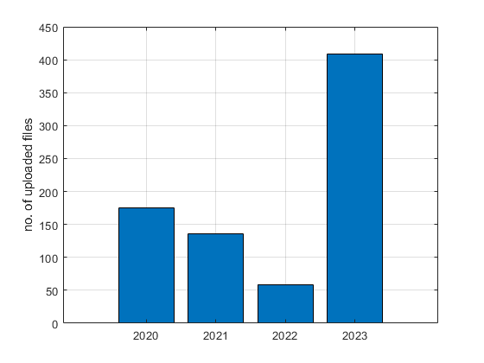
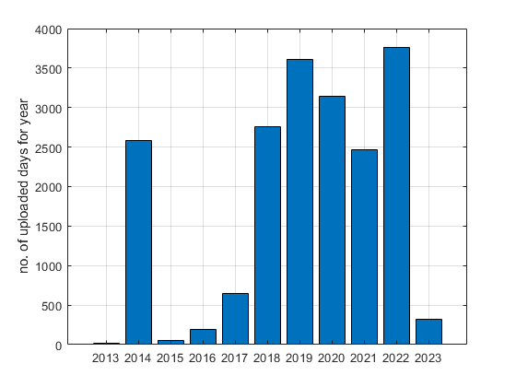
Current status of uploads and development
783 submitted hdf5 files
19 555 days of measured sound pressure levels ~ 54 years
Where do we measure ?
When were files uploaded ?
How much data per year ?

Slide 7
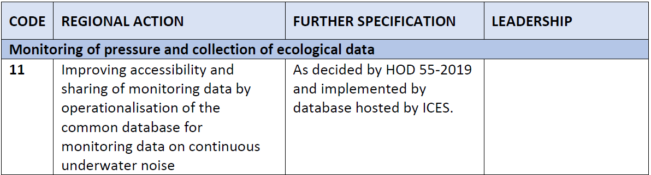
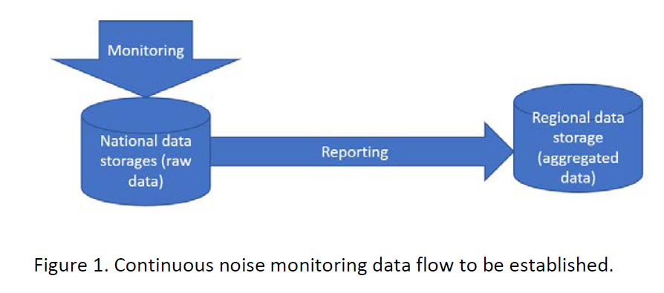
Regional Action Plan (RAP)
„Some routines and standards for uploading of data are needed. Countries are requested to upload their
quality controlled data on a yearly basis, before some suitable deadline in the year following data collection.“
Coordinated reporting and hosting of HELCOM continuous noise monitoring data, 2019
HELCOM Regional Action Plan Noise, 2023

Slide 8

Start of Introduction and status 13:40 – 14:00
Please introduce yourself
Describe your current status in measuring continuous underwater noise
Describe your status and problems with conversion and upload of continuous underwater noise data to ICES
Describe your current status and problems with reporting of impulsive noise events.
Next: Session on Impulsive Noise (14:00 – 16:00)

